Slide 1
Using your Alphability Portal
2023
https://galp.ability.efrontlearning.com/
Offcycle Intern Program

Slide 2



Access
https://galp.ability.efrontlearning.com/
Username: The email address which you provided BofA
Password: Learning2023!
Click on the course ‘Off Cycle Interns Program
2023’

Slide 3
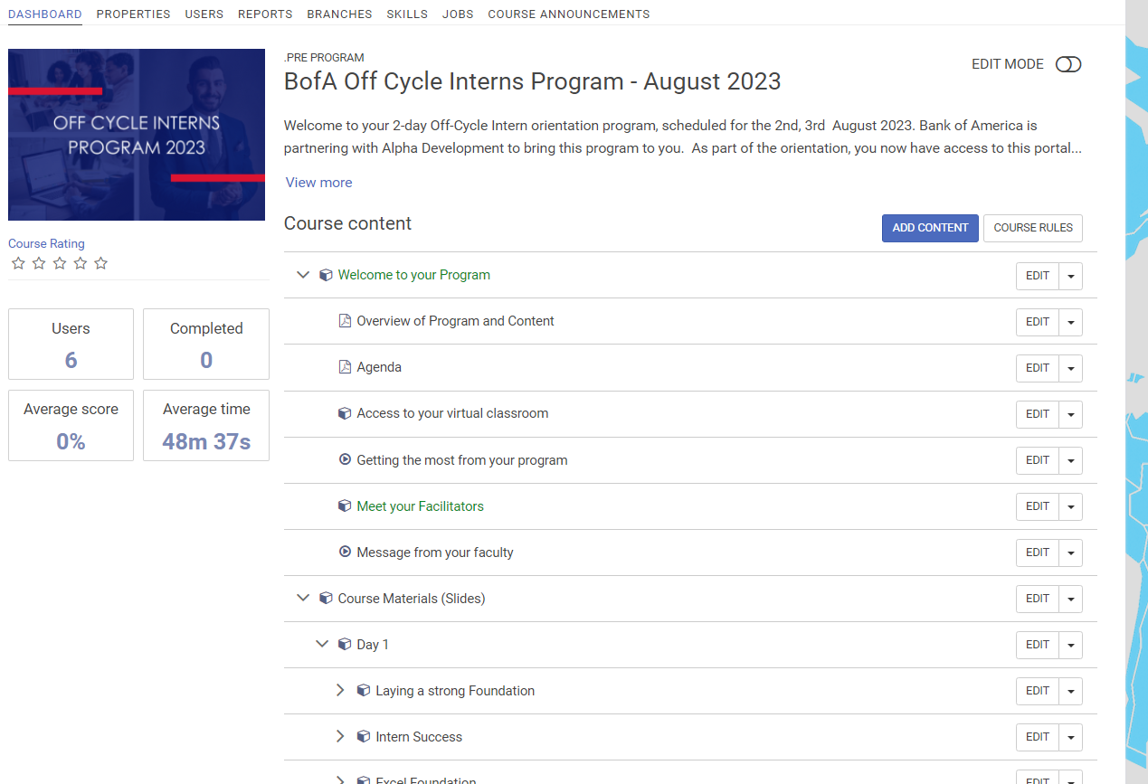
Screen Shot
Schedule
Course Materials

